Slide 1


Slide 2
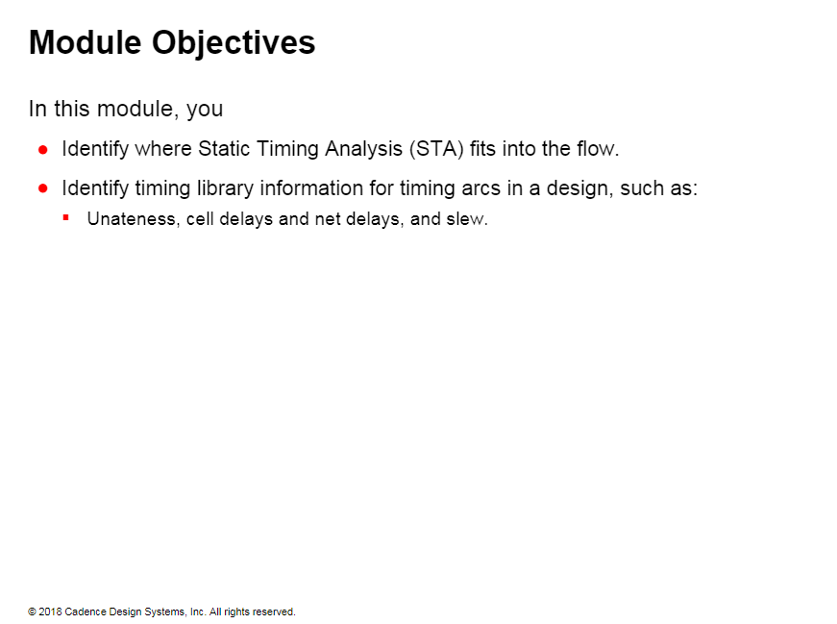

Slide 3
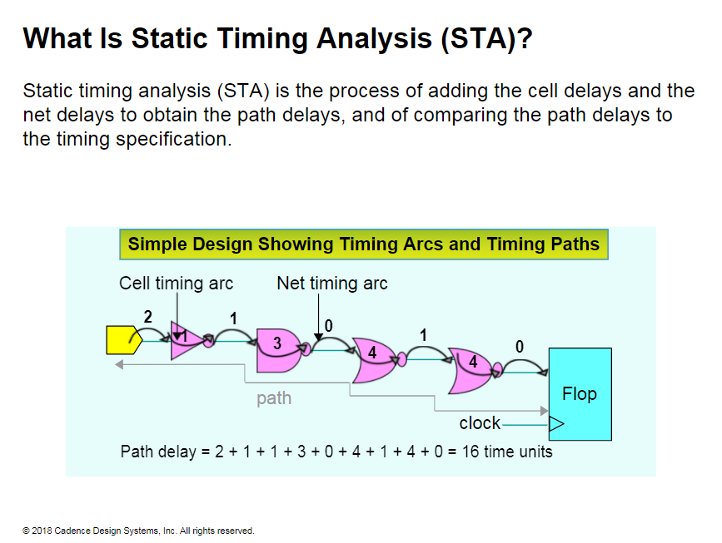
Notes:
What is Static Time Analysis ”STA”?
Static time analysis is the process of adding the delays in the paths and verifying the path delay against the timing required of the design work
This illustration shows the calculation of the path delays. The STA tool does this calculation automatically for the millions of paths in your design. Analyzing and constraining these paths properly is the focus of this course
Static timing analysis "STA" provides a different type of timing verification to check if the design will work when manufactured.
Complex designs running at high clock speeds are designed under tight timing constraints , which is very accurate but consuming.
If you are the architect or design engineer, you run a simulation to test functional aspect of the design. You also typically write the timing constraints for the STA.
If you are a synthesis, or Place and Route Engineer, you run static timing analysis to verify timing and to verify whether the design works at the required speed.

Slide 4
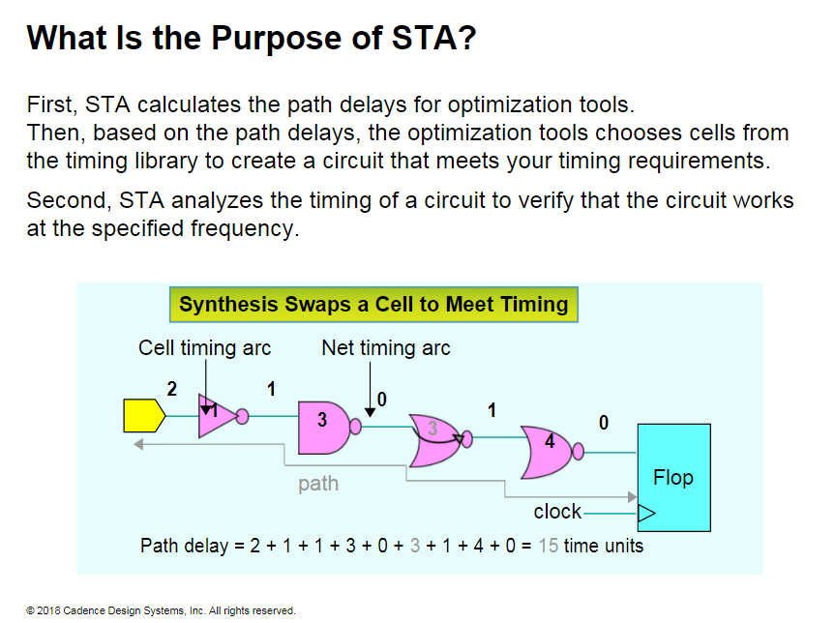

Slide 5
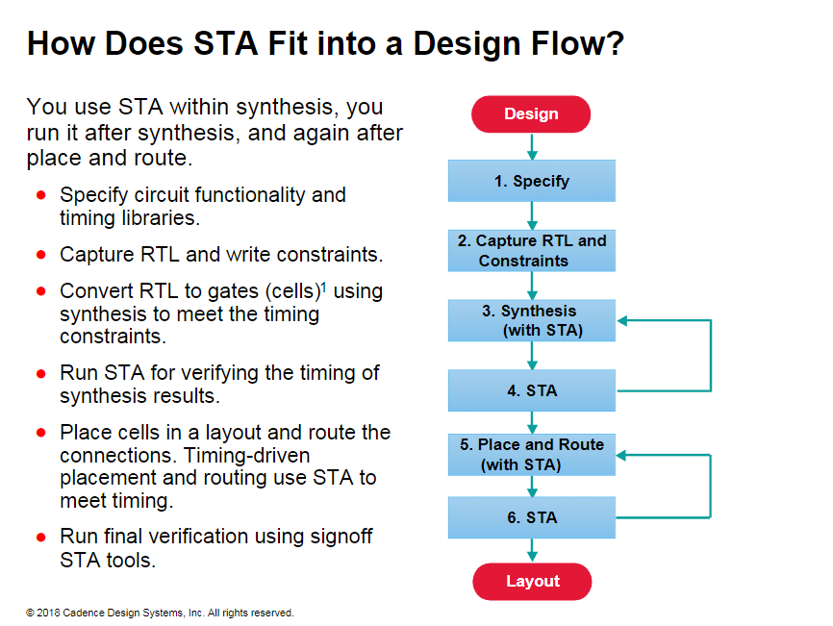
Notes:
How Does STA Fit into a Design Flow?
Cells are library models of gates. Cells and gates are often used interchangeably.
Synthesis converts behavioral RTL into gates. Then, the placement tool places the gates in a layout, and the router connects the gates while maintaining the timing requirements.
STA provides the timing data for synthesis and for place and route. You also use STA to verify timing after synthesis and after PnR.

Slide 6
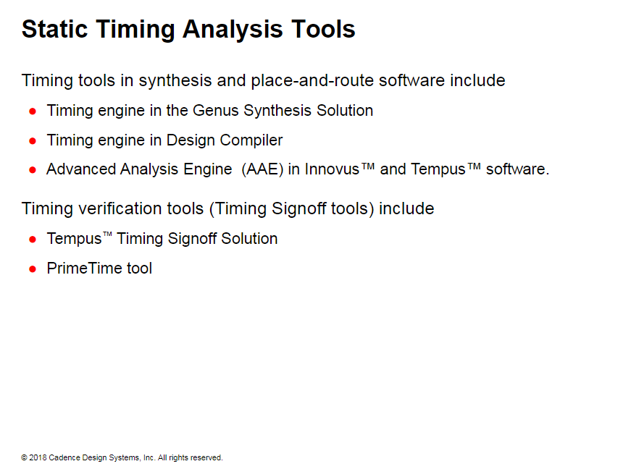
Notes:
Static timing analysis "STA" provides a different type of timing verification to check if the design will work when manufactured.
Complex designs running at high clock speeds are designed under tight timing constraints , which is very accurate but consuming.
If you are the architect or design engineer, you run a simulation to test functional aspect of the design. You also typically write the timing constraints for the STA.
If you are a synthesis, or Place and Route Engineer, you run static timing analysis to verify timing and to verify whether the design works at the required speed

Slide 7
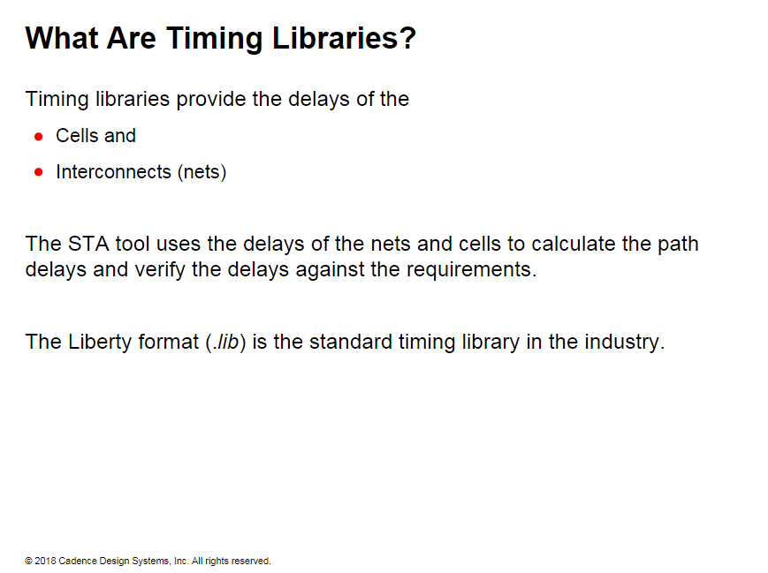

Slide 8
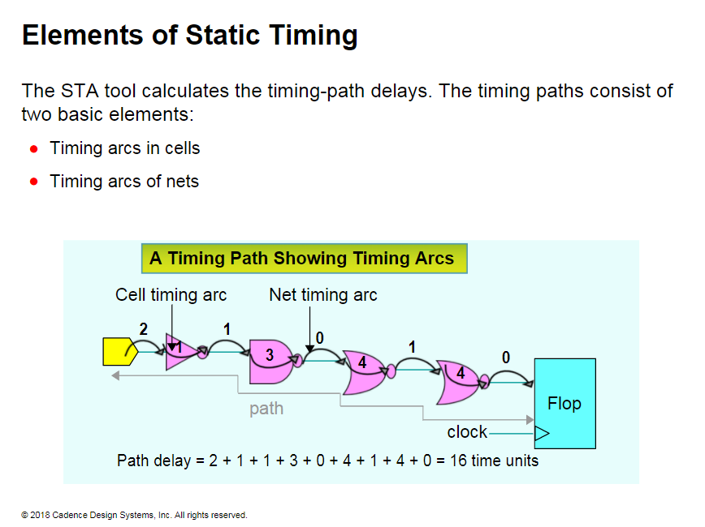
Notes:
In additional of timing arc data timing tools require:
1- clock data "the goal of timing is to restrict the path delay to a single clock period"
2- Timing check data "Timing checks define the requirements that the data has to meet before the clock can push it into a flop"

Slide 9
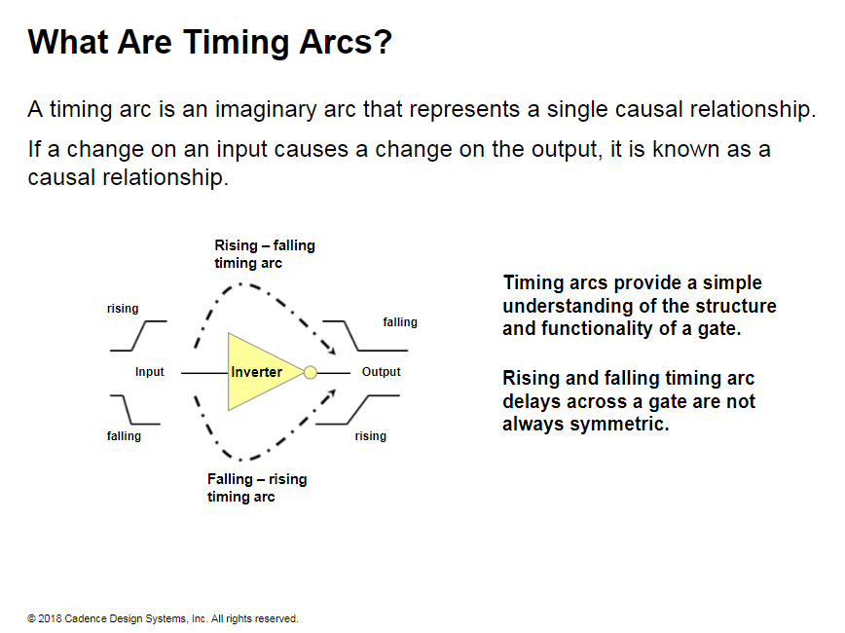
Notes:
Timing arcs are the building blocks of static timing analysis, and they provide a simple understanding of the structure and functionality of a cell or a net. Understanding timing arcs is critical important to determining the path delay correctly. every timing arc has a causal relationship. A signal transition on an input causes a transition on the output.

Slide 10
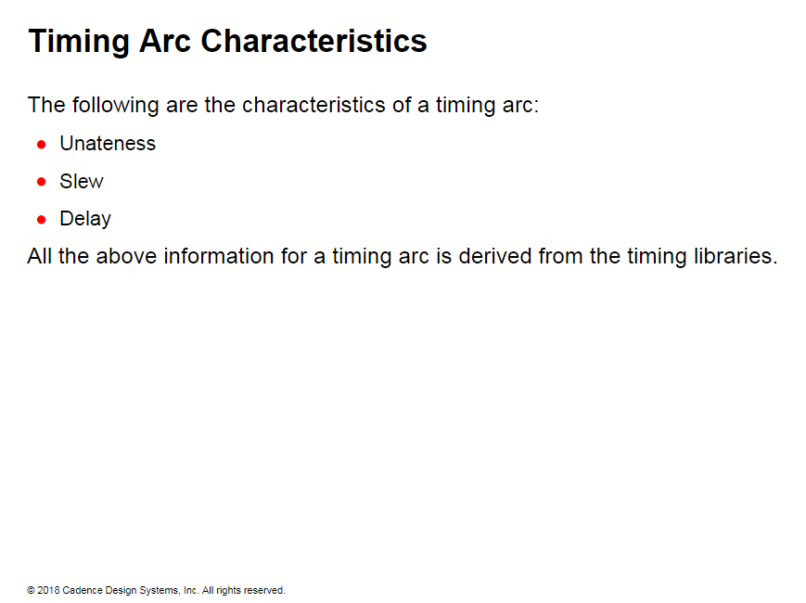

Slide 11
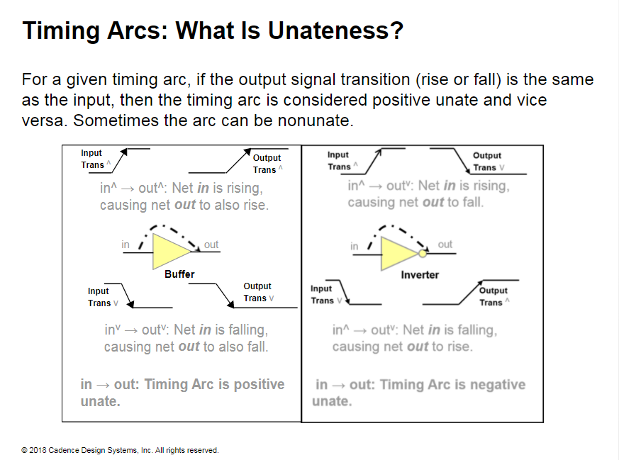
Notes:
Unnateness is an important property of all timing arcs.
Static timing analysis tool use unateness extensively.
Timing arcs of nets are always positive unate, whereas the timing arcs of the cells can be either positive, negative, or non unate.
You can easily determine the unateness of a timing arcs by looking at its truth table.
STA determines the unateness of timing arcs from the timing library

Slide 12
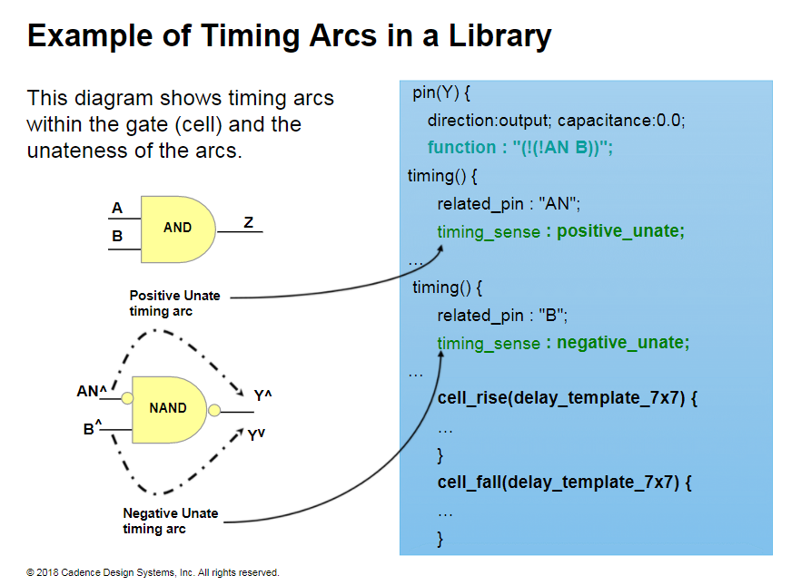
Notes:
Unateness of timing arcs are specified in the library by the timing sense attribute. When net B is rising, net Y would be falling, and hence the timing arc is negative unate. When net A is rising, net Y would be rising, and hence the timing arc is positive unate.
Audio: Example of Timing Arm in a Library
Every input to output combination forms a timing arc.
Each related pin under the timing section of the output pin represents a timing arc.
Unateness of timing arcs are specified in the library by the timing sense attribute.
When net B is rising, net Y is falling. Therefore, the timing arc is negative unate.
When net A is rising, net Y is rising. Therefore, the timing arc is positive unate.

Slide 13
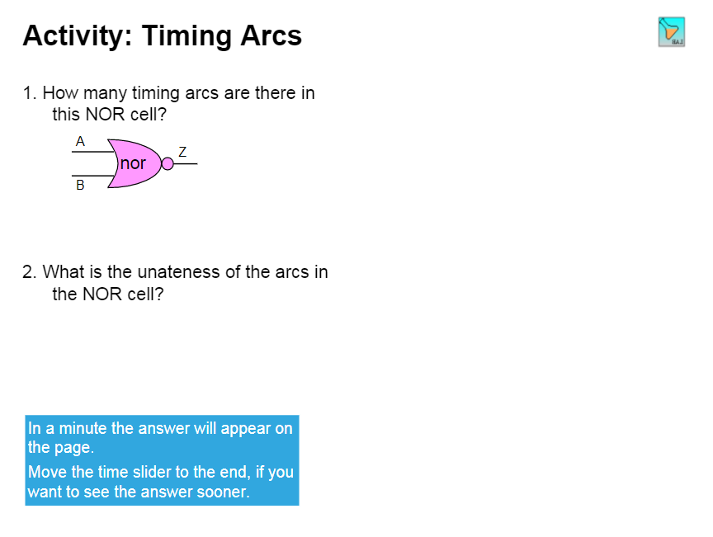
Notes:
Solution
1. A NOR gate has 2(2C1) input to output combinations. Each arc has two valid transitions, rise and fall. Therefore, you have 4 timing arcs.
2. From the truth table of the NOR you can see that When either of the inputs are rising, the output is falling, and vice versa. Therefore, both the timing arcs of a NOR gate are negative unate.

Slide 14
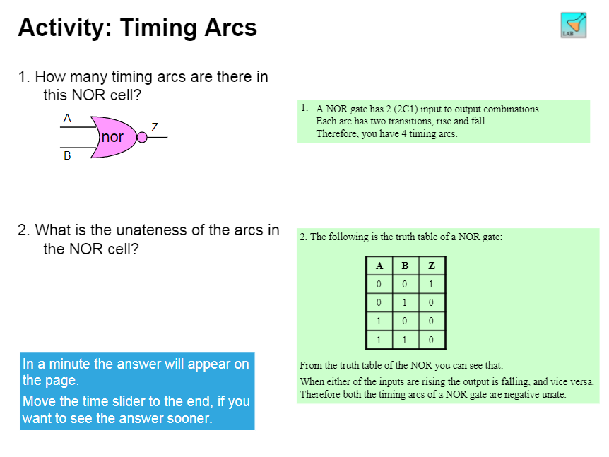

Slide 15
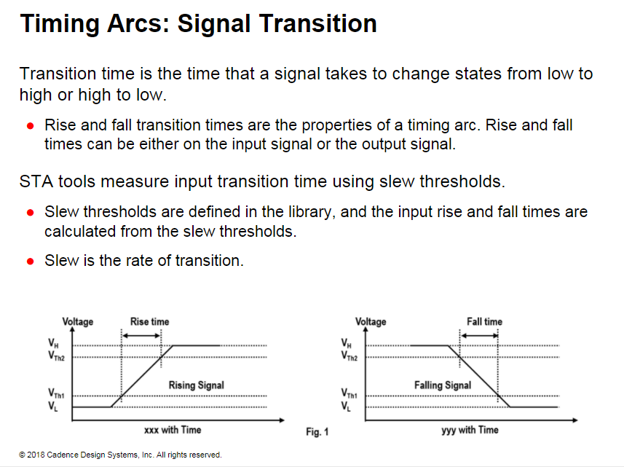
Notes:
Technically, the rate of the transition is measured in Volt/ns, and this is the slew.
Transition time and rise and fall times are measured in terms of time, typically ns.

Slide 16
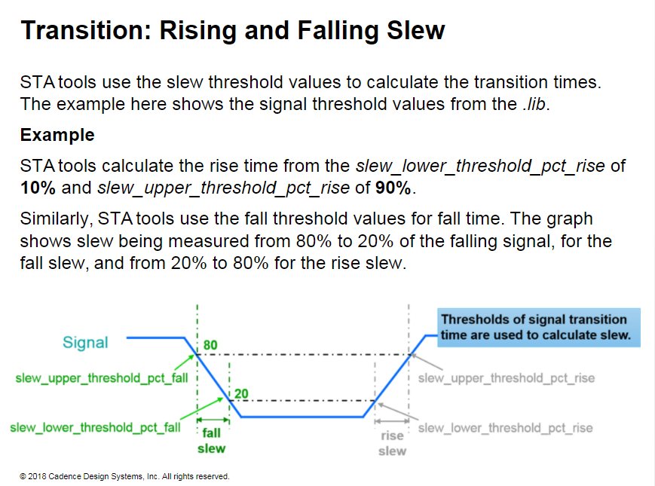
Notes:
The threshold values are used to calibrate the delays specified in the library. So when the thresholds specified in the library do not match the thresholds used, then the STA tools scale the thresholds to calculate the delays and dews.
Threshold scaling is done for parasitic based calculations (Steiner and SPF), and changing thresholds affect slew/delay.
Threshold scaling is not done for wire-load based calculations, delay and slew numbers are straight from the library.
All semiconductor devices take some time to switch between states. The transition time is the time it takes for a signal to rise or fall. The upper threshold value determines the actual time at which a device turns on and stays on. The lower threshold value determines the time at which the device turns off and stays off. In the illustration above, the lower thresholds are 20%, and the upper thresholds are 80./0. The rise transition is measured from 20% to 80% of the signal, and the fall transition is measured from 80% to 20%.

Slide 17
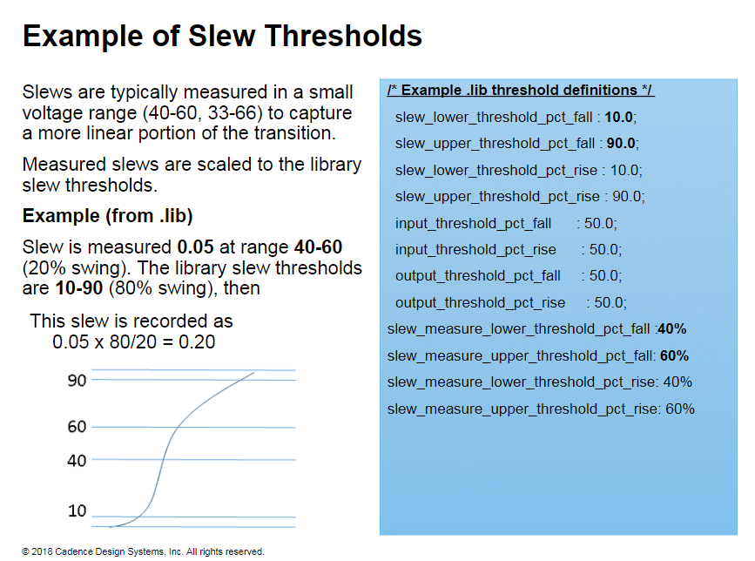
Notes:
slew measure_lower/u pperthreshold_pctr ise/fall
• Define how slew data are measured during SPICE characterization.
• Slew measured thresholds let the delay calculator perform measurements on its derived waveform.

Slide 18
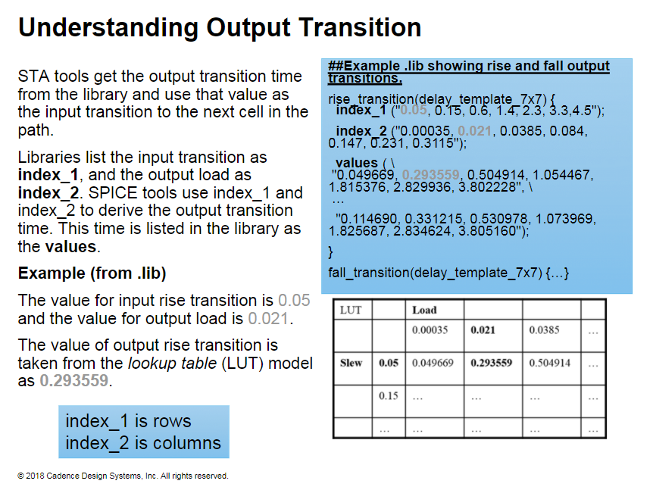
Notes:
Each library cell model also contains the cell's output transition computed as a function of the input slew and output load. Then, it is used as the next cell's input transition to calculate its delay.
The table is an example of a lookup table (LUT) in a more readable format than the library information shown above.

Slide 19
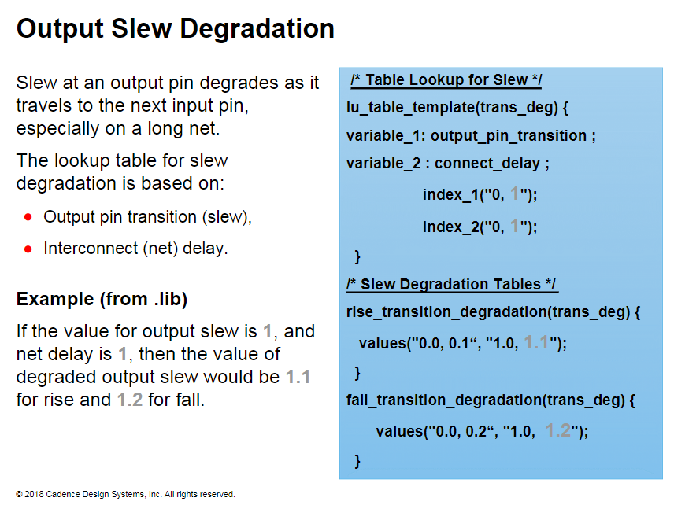

Slide 20
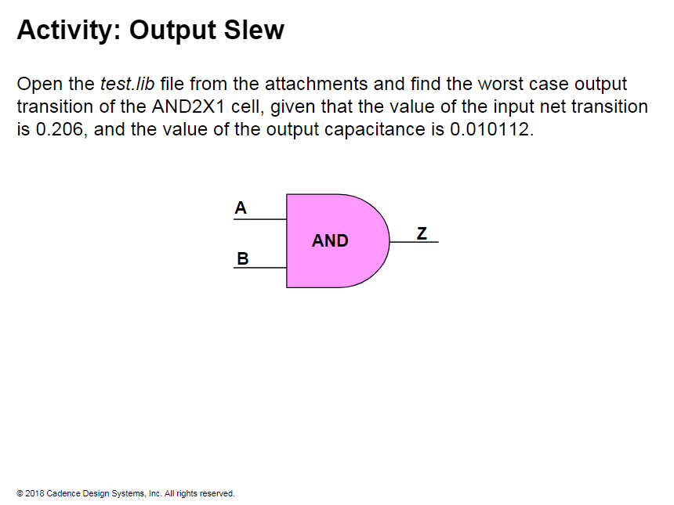
Notes:
Solution
In the library, you will find this LUT for the rise transition of the A —> Z arc: rise_transition (delay_template 7x7) { index_1 ("0.042, 0.066, 0.112, 0.206, 0.392, 0.764, 1.5"); index_2 ("0.00079, 0.002054, 0.00474, 0.010112, 0.020856, 0.042186, 0.08532"); values (3 .0.049964, 0.064096, 0.095169, 0.160213, 0.295482, 0.567142, 1.116929", \ "0.050165, 0.064589, 0.095406, 0.160276, 0.295541, 0.567171, 1.116947", \ "0.050550, 0.064846, 0.095540, 0.160350, 0.295551, 0.567165, 1.116943", \ "0.052987, 0.067255, 0.096955, 0.160932, 0.295615, 0.567169, 1.116939", \ Therefore, for the index 1 of 0.206 and index _2 of 0.010112, the rise transition is 0.160932.
From the library, input slew and output load are the index_1 and index_2 from delay_template 7x7. Then, under the transition tables for AND2X1, we find: The value of cell delay for A → Z rising = 0.160932, The value of cell delay for A → Z falling = 0.097039, The value of cell delay for B → Z rising = 0.160815, The value of cell delay for B → Z falling = 0.098912. Therefore, the worst transition time would be the rise time of Z when A is rising.

Slide 21
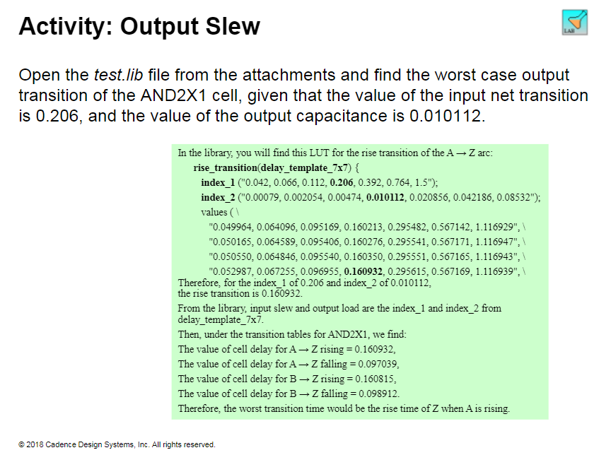

Slide 22
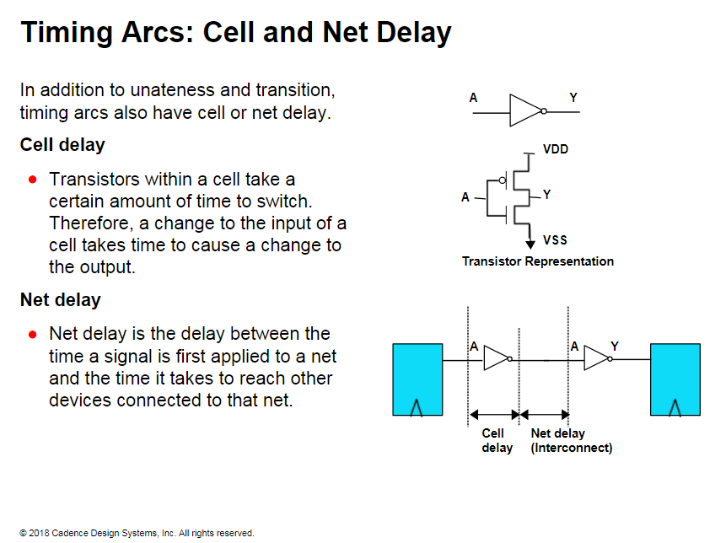
Notes:
Depending on the process technology, different physical elements have different levels of contribution.
Each stage delay (Cell delay + Net delay) represents the time required to propagate a signal from the input of one gate to the input of the next.
Delays encountered in digital circuitry are composed of two main components: cell delay and net delay.
Historically with process technologies above 90 nanometers cell delay has been the major limiting factor in timing closure. However, at process technologies below 90 nanometers, net delays dominate the cell delays.

Slide 23
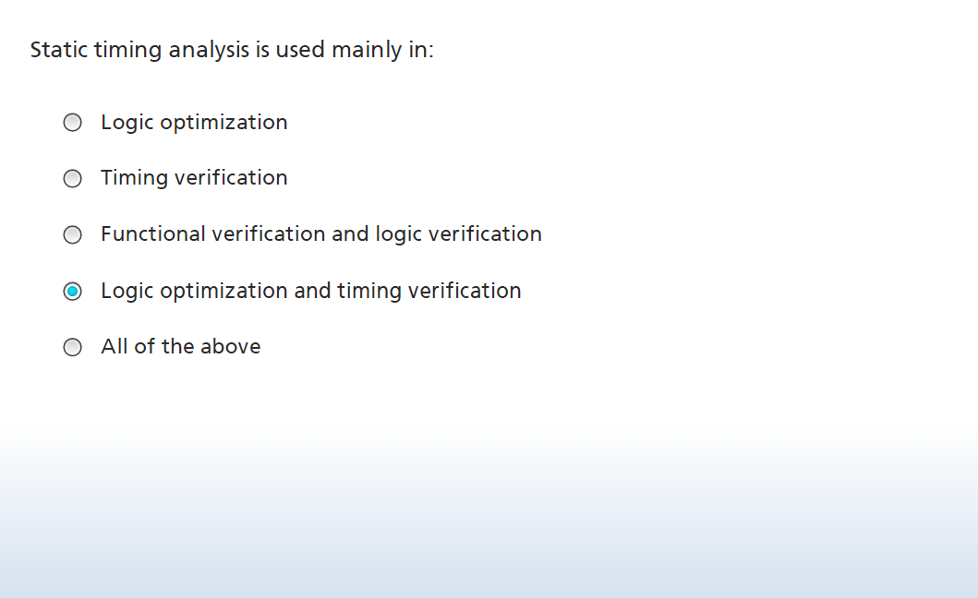

Slide 24
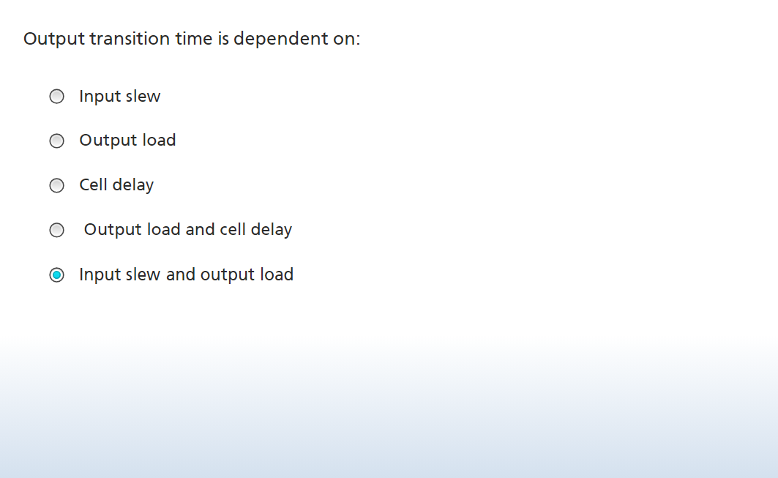

Slide 25
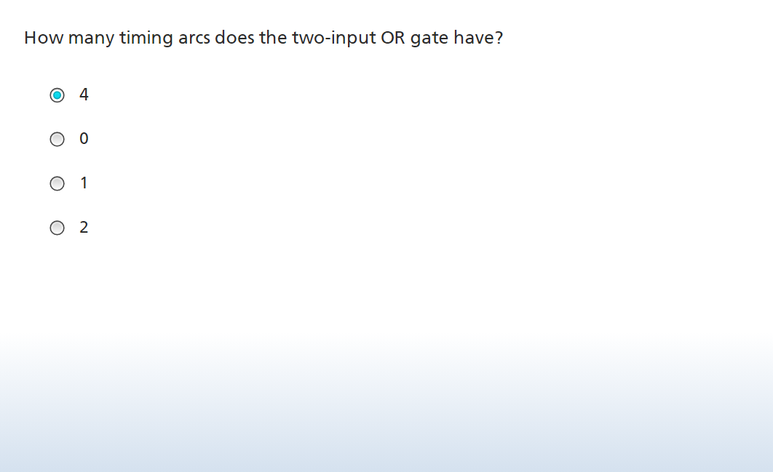

Slide 26
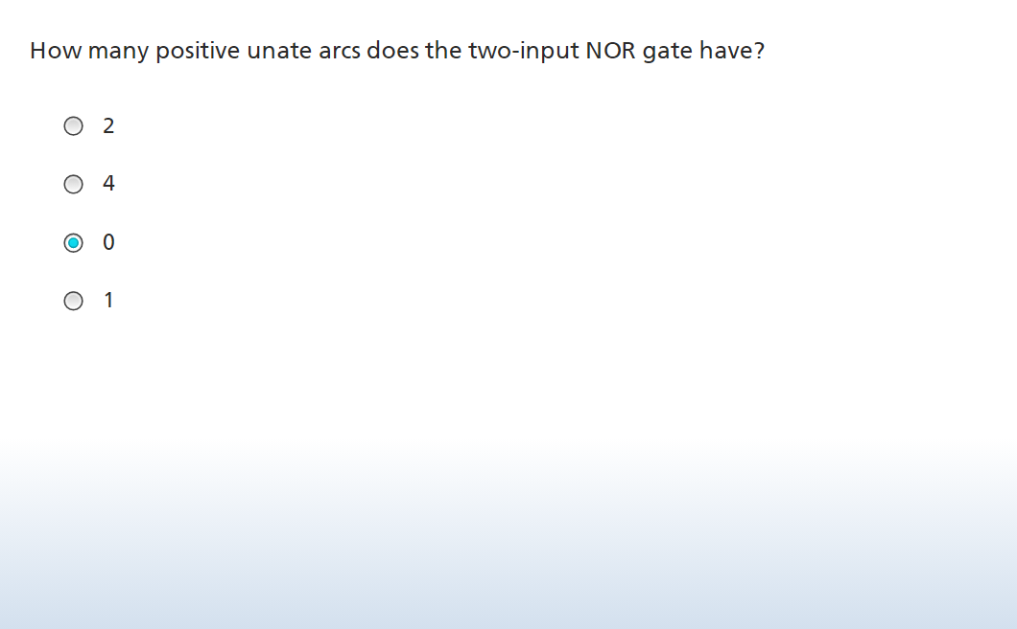

Slide 27
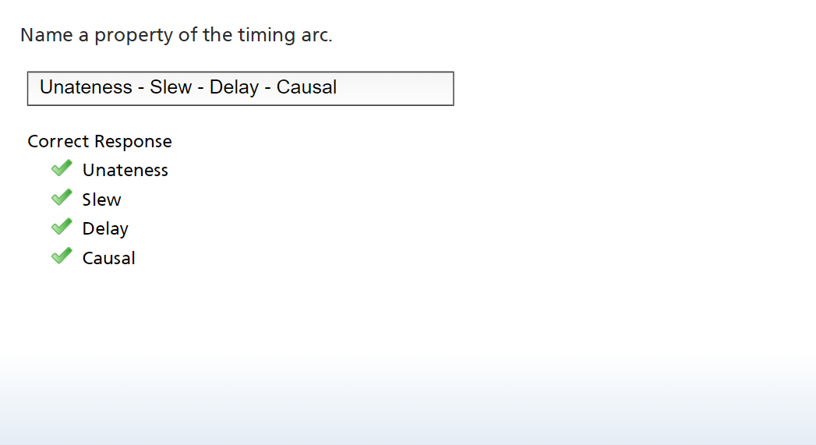

Slide 28
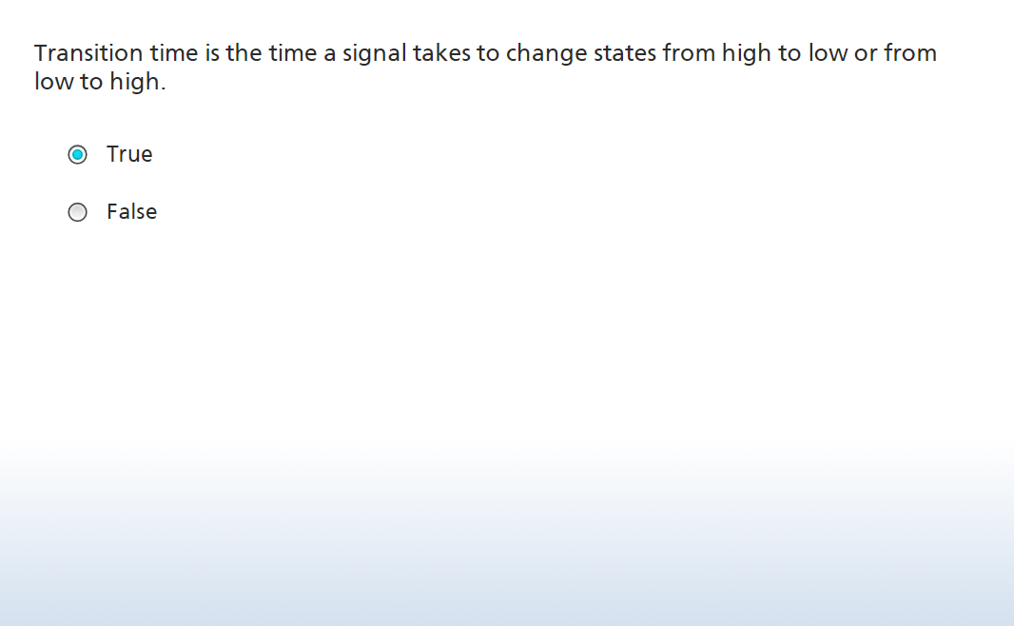

Slide 29
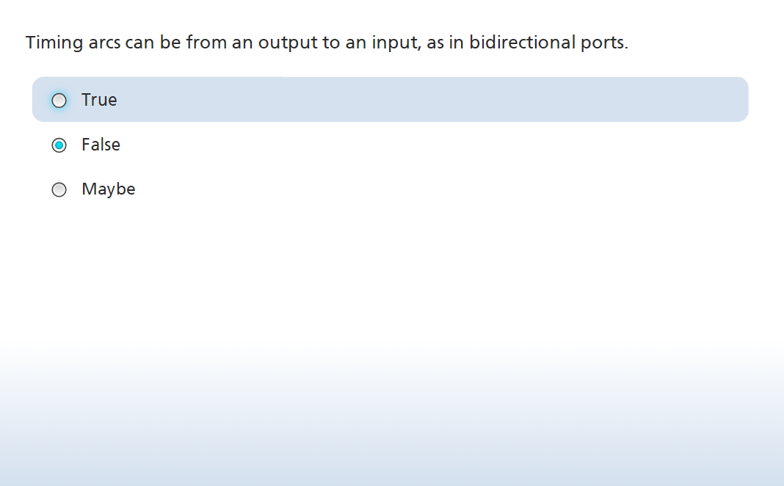

Slide 30
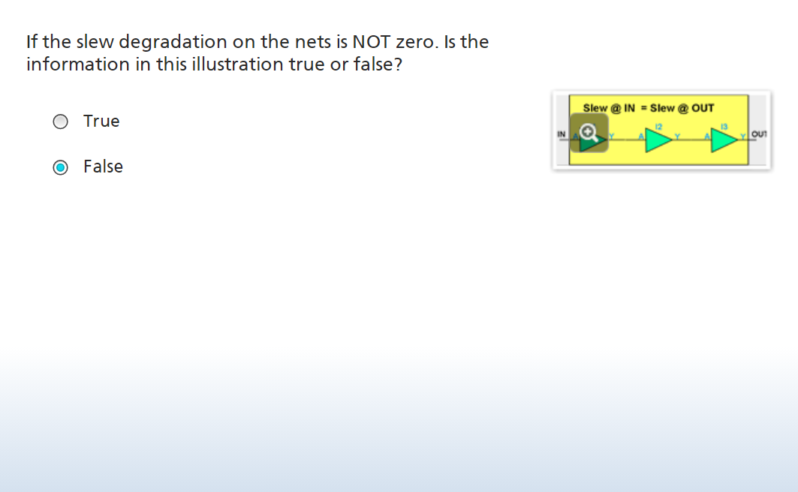
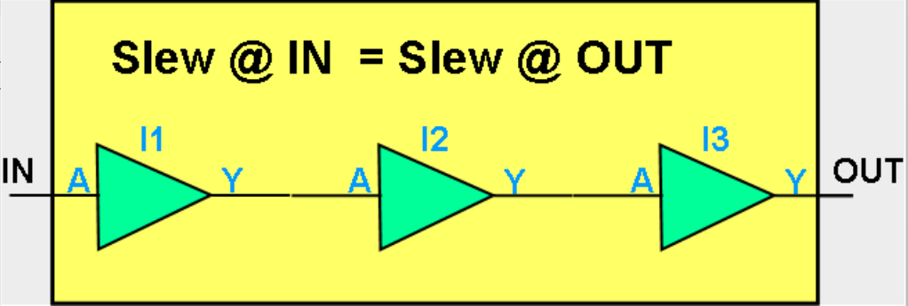

Slide 31
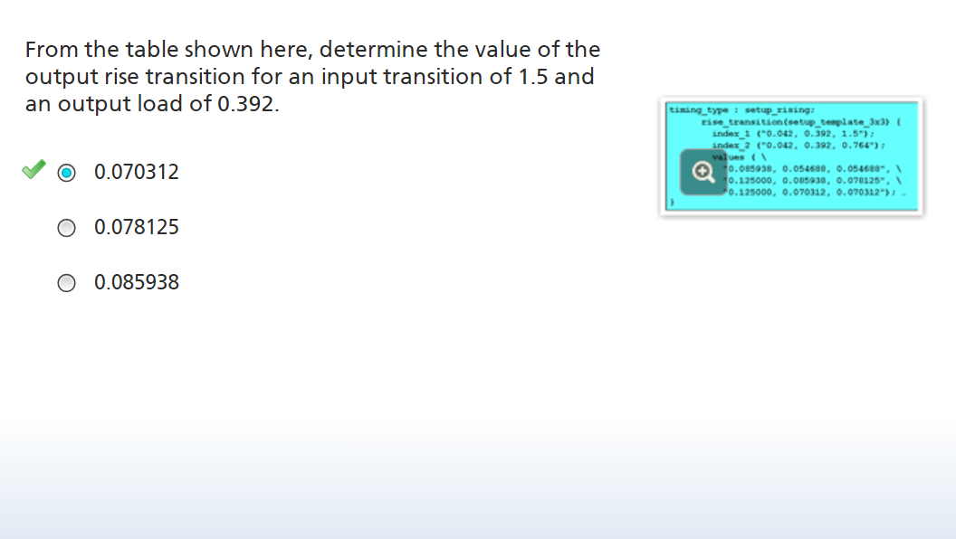

Slide 32
